Slide 1


Modelling phospholipid Bilayers with Day/Night temperature fluctuation
Dr. Trembath-Riechert, Chanel Vidal, Chenou Zhang,
Colin Boecker-Grieme
Arizona State university
cboecker@asu.edu

Slide 2
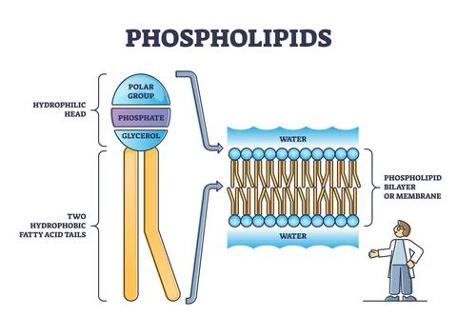
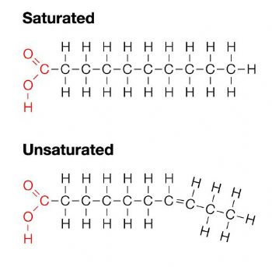
Why are lipids important?
Lipids have wide variety of cellular roles
Lipid roles in the cell membrane
Importance of controlling fluidity
Membrane phospholipid composition
Hydrophilic head group
Hydrophobic tail group
Lipid spacing
Saturated vs unsaturated
Implications of understanding lipid membrane function
Lipids as biosignatures
Notes:
Beyond serving as an energy source or a membrane component, every lipid class has a unique biological role. These include but are not limited to the trafficking of cellular constituents, the regulation of the
activities of membrane proteins and signaling, and playing a role in the immune system.
In cell membranes, their purpose is to control the transport of materials such as signaling molecules, provide a barrier against molecules when they are unneeded, and regulate membrane permeability and fluidity.
Controlling how what goes through and how much goes through the membrane is crucial for cell survival. Controlling the environment inside the cell against the outside is key for retaining desired materials and keeping undesired materials out. Fluidity on the cell determines a how similar the concentration gradient in the cell is to the outside. Lowering the fluidity would bar against an unfavorable concentration shift and increasing fluidity would welcome a favorable concentration shift. How fluidity is controlled can go beyond just saturated or unsaturated lipids but also by adjusting the type of lipids present and the length of a lipids in the membrane.
Membrane lipids are composed of a hydrophilic headgroup and two hydrophobic fatty acid tails. These form a bilayer with the hydrophilic groups facing outwards and hydrophobic tails facing inwards. The length of the fatty acid tails depends on the amount of carbon atoms in the tail and can be differentiated by the amount. For example, a C-14 fatty acid tail would have 14 carbon atoms in the tail.
One method that cells have of controlling their membrane fluidity is adjusting the spacing of the lipids in the membrane by altering the fatting acid saturation. A saturated lipid’s fatty acid tails are straight allowing for tighter packing. An unsaturated lipid has at least one bent fatty acid tail with a lipid having multiple bent tails or multiple bends in a tail referred to as polyunsaturated. This bending increases the spacing between lipids and a high amount of unsaturation in a cell membrane increases the membrane’s fluidity.
Understanding lipid function helps us understand how microbes survive. These means that for bacterial infections we have a better shot at ending the infection once we understand how the bacteria causing the infection uses its lipids membrane to survive. There are also a variety of human diseases that are linked to lipid membrane dysfunction. Understanding lipid membranes would help us understand what is going wrong and how to fix the dysfunction. Targeted therapies, efficient drug delivery, and disease prevention are important goals that a better understanding of lipid membranes would contribute towards. Lipids also act as potential biosignatures. Lipid hydrocarbon backbones becoming microfossils not only can give us a window into the past of our world and its environmental change but have the potential to give us windows into the past of other worlds should they be discovered there.

Slide 3
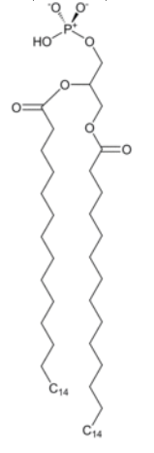
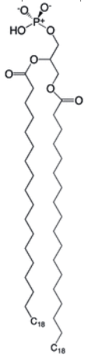
Developing a Computational modelling guide as a supplement
A molecular dynamics modeling approach
Increase replicability of lab work
Contribute to discerning errors
Experimental Materials
CHARMM-GUI
Gromacs-md
The Sol Supercomputer
Experimental Set up
C-14 Lipids at 10ºC and 30ºC
C-18 Lipids at 10ºC and 30ºC
Hypothesis: Due to larger lipid profiles being preferred higher temperatures, the C-18 lipid will be preferred at 30ºC and the C-14 lipid will be preferred at 10ºC
C-14 Lipid courtesy of CHARMM-GUI
C-18 Lipid courtesy of CHARMM-GUI
Notes:
Computational modeling of phospholipid bilayers can act as a useful supplement to lipid lab work. Knowing how lipids act in computer simulations can inform how experiments should be set up to most accurately replicate environmental conditions. Knowing how to more accurately set up experiments can lead to more standardized experimental procedure increasing replicability of lab work. Computer experiments can do this be being help to help discern errors in experiments and fixing those errors.
CHARMM-GUI is a molecular dynamics input generator used here to build the membrane bilayer for the simulation but with a far greater capacity for input generation. Gromacs-md is the simulation software used to simulate the membrane bilayer. The computational resources for the experiment were provided by the ASU Sol Supercomputer improving the runtime of each simulation.
In order to ground truth computational modelling guide, a molecular dynamics simulation replicating Chanel’s laboratory experiment. C-14 and C-18 lipids were generated in charmm-gui and then simulated in gromacs at 10 degrees Celsius and 30 degrees Celsius with the former temperature representing night time average temperature and the latter temperature representing daytime average temperature. The size of these simulations were relatively small at only 27/28 lipids in the top leaflet of the bilayer and 27/28 in the bottom leaflet. The end goal of this experiment would be to supply information to strike a balance between a static and shaking incubation methods. More experiments would need to be run in order to properly determine that balance.

Slide 4
Results - RMSD
Root Mean Square Deviation: the deviation of a structure from a reference (original) structure over time.
Y-axis in nanometers (nm)
X-axis in nanoseconds (ns)

Slide 5
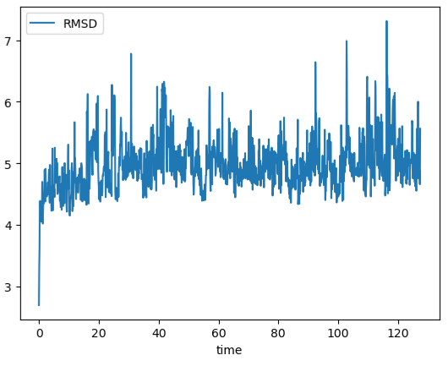
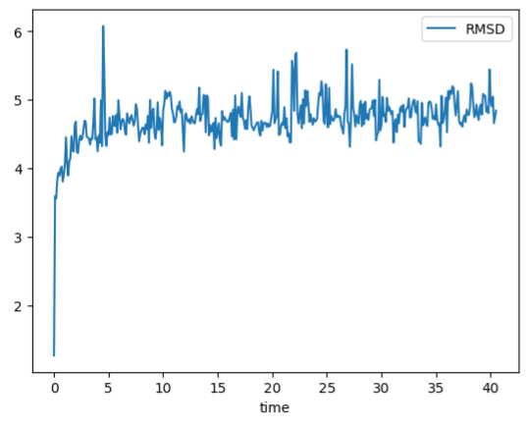
RMSD Plots of C-14 Phospholipids
RMSD Plot of C-14 phospholipid at 30 degrees Celsius
RMSD Plot of C-14 phospholipid at 10 degrees Celsius

Slide 6
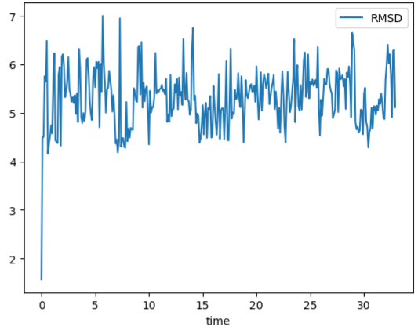
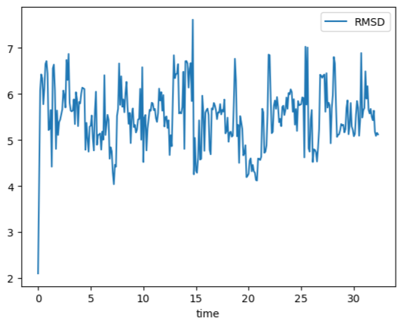
RMSD Plots of C-18 Phospholipids
RMSD Plot of C-18 phospholipid at 30 degrees Celsius
RMSD Plot of C-18 phospholipid at 10 degrees Celsius

Slide 7
Results - Gyration
Gyration plot: visualizes the radius of gyration of the system
Radius of gyration: the average distance of a system's atoms from their center of mass.
Y-axis in nanometers (nm)
X-axis in picoseconds (ps)

Slide 8
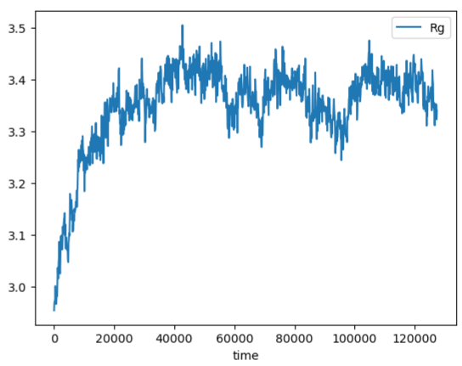
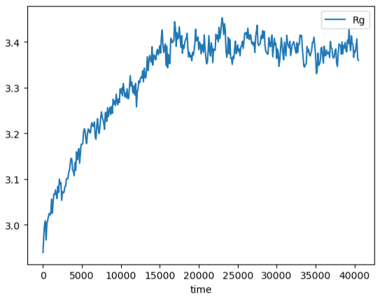
Gyration Plots of C-14 Phospholipids
Gyration Plot of C-14 phospholipid at 30 degrees Celsius
Gyration Plot of C-14 phospholipid at 10 degrees Celsius

Slide 9
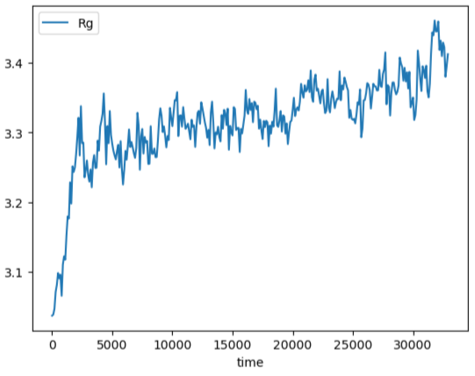
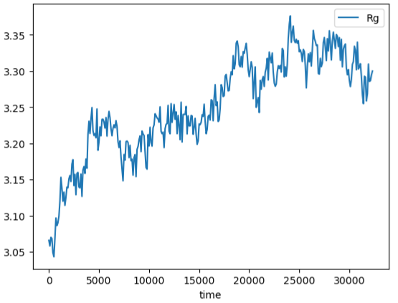
Gyration Plots of C-18 Phospholipids
Gyration Plot of C-18 phospholipid at 30 degrees Celsius
Gyration Plot of C-18 phospholipid at 10 degrees Celsius

Slide 10
Discussion and conclusions
C-14 performed better in the RMSD graphs and Gyration Graphs
The C-18 performed better at 30 degrees Celsius than 10 degrees Celsius
The C-14 lipid performed better at 10 degrees Celsius than 30 degrees Celsius
The hypothesis is not supported.
Possible Errors
Future Directions
C-14 at 30 degrees simulation run time far exceeding other three – rerun other three for a longer period.
Testing with more complex membranes
Testing more environmental conditions
Notes:
C-14 performed better in the RMSD graphs and Gyration Graphs
RMSD graphs for the C-14 lipid had a lower average at stabilization of between 4.5 nm to 5 nm compared to the RMSD graph for the C-18 lipid at an average of about 5.5 nm.
Radius of Gyration graphs stabilized at about 3.4 nm for the C-14 lipid; did not seem to stabilize for the C-18 lipid.
This means that the C-14 lipid both deviated less from the original structure and remained more compact than the C-18 lipid at both 10 and 30 degrees Celsius.
The C-18 performed better at 30 degrees Celsius than 10 degrees Celsius
The C-18 lipid had less variation at stabilization in the RMSD at 30 degree Celsius and was closer to stabilization in the radius of gyration graphs at 30 degrees Celsius.
The C-14 lipid performed better at 10 degrees Celsius than 30 degrees Celsius
The C-14 lipid got to stabilization quicker in the gyration plot at 10 degrees Celsius and seems to be less variable in the RMSD plot at 10 degrees Celsius.
The hypothesis is not supported. While the fact that C-18 lipid performed better at 30 degrees Celsius and the C-14 lipid performed better at 10 degrees Celsius, the C-14 lipid performed better overall.
The C-14 at 10 degrees Celsius, and the C-18 at both 30 and 10 degrees Celsius had much more limited simulation run times than the C-14 at 30 degrees Celsius.
Rerunning the 3 more limited simulations so that the run times are longer and more equivalent to the C-14 at 30 degrees Celsius simulation length would answer whether this was an error or not.
Testing with more complex membranes
Unsaturated membranes; Mixes of unsaturated and saturated lipids; Modelling a real membrane
Testing more environmental conditions
Extreme cold
Extreme heat
Extreme ionic conditions
Modelling Extraterrestrial locations

Slide 11


acknowledgements
Supported in part through the Arizona NASA Space Grant Consortium, Cooperative Agreement 80NSSC20M0041
I would like to acknowledge Dr. Elizabeth Trembath-Reichert for funding and mentoring and Chanel for mentoring during this research project
I would like to acknowledge Chenou Zhang for teaching me how to run a simulation using gromacs
I would like to acknowledge Gromacs-md, CHARMM-GUI, and the Sol Supercomputer and ASU Research Computing for providing resources for this research project
Sources
Please email me at: cboecker@asu.edu

Slide 12
Questions?

